Slide 1
24 second rule
English
Practical way of working during a game
Updated 2024-08-13

Slide 2
The purpose of the rule is that an offense should not last forever…
Simplified, the following applies…
You have 24 seconds to shoot and score or the ball touches the ring.
If you take the rebound, and continue your offense, you only have 14 seconds to shoot again (because then you are already in the other team half of the court).
Time starts counting when a team gains control of the ball on the field and stops counting in practice when the referee stops the game.
It is ALWAYS the referee's signal that applies. - Despite the "shot clock" signalling that time is up! - The game continues until the referee blows the whistle.

Slide 3
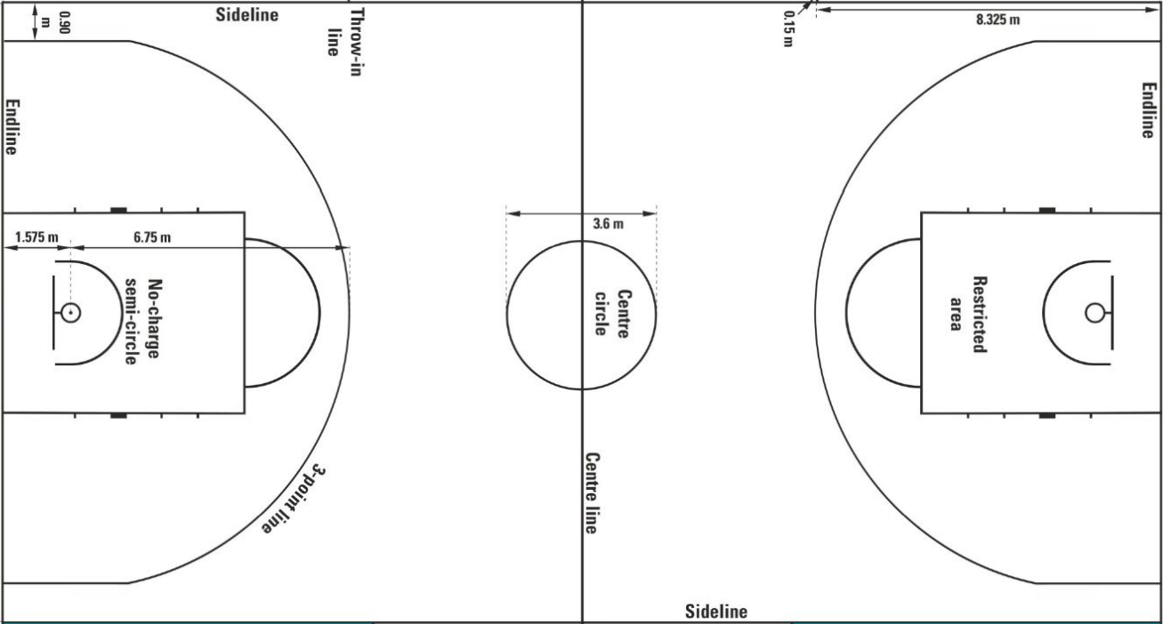
Our example
Yellow team half-court
Blue half-count – Where Yellow scores!
Direction of play
The example has the Yellow team view

Slide 4
Generally – what should the clock say?
Yellow team half-court
Blue half-count – Where Yellow scores!
At least
14
24
Direction of play
There are special cases - as shown in the following slides..

Slide 5
At least 14 seconds?
If the team has more than 14 seconds left on the shot clock, the team keeps them.
If stock has less than 14 seconds left on the shot clock, stock gets 14 new seconds.
E.g.
The team has 17 seconds left. Then they keep their 17 seconds. Do not change the shot clock.
The team has 6 seconds left. Then the team gets 14 NEW seconds. The shot clock is set to 14 seconds.

Slide 6
Offence team keep the ball after stop
Yellow team half-court
Blue half-count – Where Yellow scores!
Offence team is fouled
Other stop caused by other team
Offense team is fouled
Other stop caused by other team
Direction of play
At least
14
DO NOT change the Shot Clock if the ball goes over the sideline - I.e. the Offense team had the ball, the defenders had the ball out AND the Offense team gets a throw-in (gets the ball again)
24
Shot / Score?
Next slides…
§ 29.2.1

Slide 7
Defence team gets throw in
Yellow team half-court
Blue half-count – Where Yellow scores!
Offence team (blue) drops out the ball themselves
Offence team (blue) breaks other rules (referee knows the rules)
Offence team (blue) drops out the ball themselves
Offence team (blue) breaks other rules (referee knows the rules)
Direction of play
Shot / Score?
Next slides…
The YELLOW players get the ball AND the play will change Direction
24
14
§ 29.2.2

Slide 8
Stealing the ball ”Steal” => ALLWAYS 24 sec
Yellow team half-court
Blue half-count – Where Yellow scores!
The defenders (blue) steal the ball, "Steal". E.g.:
  Breaks / goes between a pass
  Takes / snatches the ball from the offense team, without jump ball
The defenders (blue) steal the ball, "Steal". E.g.:
  Breaks / goes between a pass
  Takes / snatches the ball from the offense team, without jump ball
Direction of play
Shot / Score?
Next pages…
24
Note the play will change Direction
24
§ 29.1.1

Slide 9
Shot & Score

Slide 10
Yellow team shoot AND hits the ring AND take the rebound.
Yellow team half-court
Blue half-count – Where Yellow scores!
If the ball hits the ring, the clock is ALWAYS set to 14 seconds!
hits the ring
AND
take the rebound
Direction of play
Even if there are more seconds left
14
§ 29.2.6

Slide 11
Yellow team shoot, Misses the ring, takes the rebound.
Yellow team half-court
Blue half-count – Where Yellow scores!
Became a pass to the team mate
Misses the ring
take the rebound
Direction of play
Rör EJ
klockan!
§ 29.1.1

Slide 12
Yellow team shoot, hits the ring, Misses the rebound.
Yellow team half-court
Blue half-count – Where Yellow scores!
24 sec as the Other team takes the rebound
hits the ring
Other take the rebound
Direction of play
Direction of play
Other team ball! => 24
NOTE that the game will change Direction of play when the Other team (blue) takes the ball
§ 29.2.6

Slide 13
Yellow team shoot, Misses the ring, Misses the rebound.
Yellow team half-court
Blue half-count – Where Yellow scores!
24 sec as Other team takes the rebound
Misses the ring
Other team takes the rebound
Direction of play
Other team ball! => 24
Note the play will change direction when the blue team gets the ball
§ 29.1.1

Slide 14
When Yellow team shoot AND scores!
Yellow team half-court
Blue half-count – Where Yellow scores!
Scores!
Direction of play
Other team ball! => 24
Note the play will change direction when the blue team gets the ball
§ 29.1.1

Slide 15
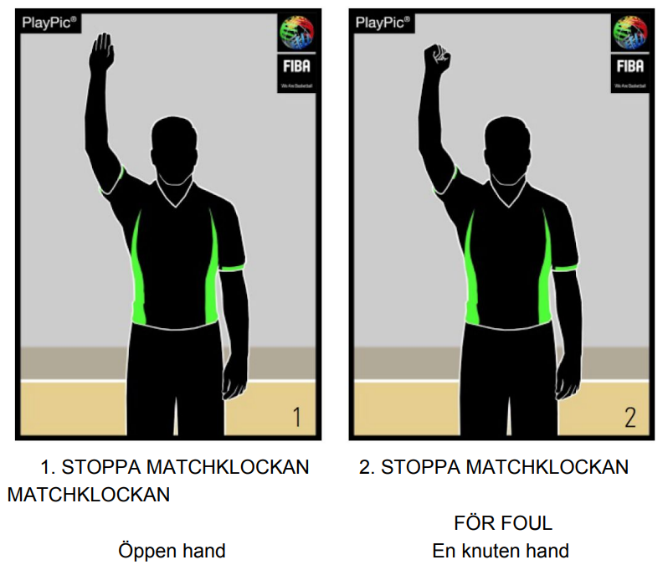
When do I STOP the Shot Clock?
When the referee stops the match!
Blows the whistle.
ADVICE.
Set the Shot Clock to start AND stop with the Game Main Clock.
Then you don't need to use the Start AND Stop buttons on the 24 sec control.

Slide 16
When do I START the Shot clock?
What if:
What should the Shot Clock be set to, when the team makes a throw-in after Score – AND the other team intercepts the pass and takes the ball.
*) except for the last 2 minutes of the 4th per AND overtime
When the team gains control of the ball.
Tricky!
Keep in mind that the match clock starts after the opponent score. *)
But.. The shot clock must not go!!”… the team gained control of the ball.”
By the book, you should use the start AND stop buttons on the Shot Clock …
A little cheat to avoid the start AND stop buttons☺
When the team scores - set the Shot Clock to 24 sec ASAP (avoid the horn)
When a team gains control of the ball - set the Shot Clock to 24 sec again!
§ 29.1.1

Slide 17
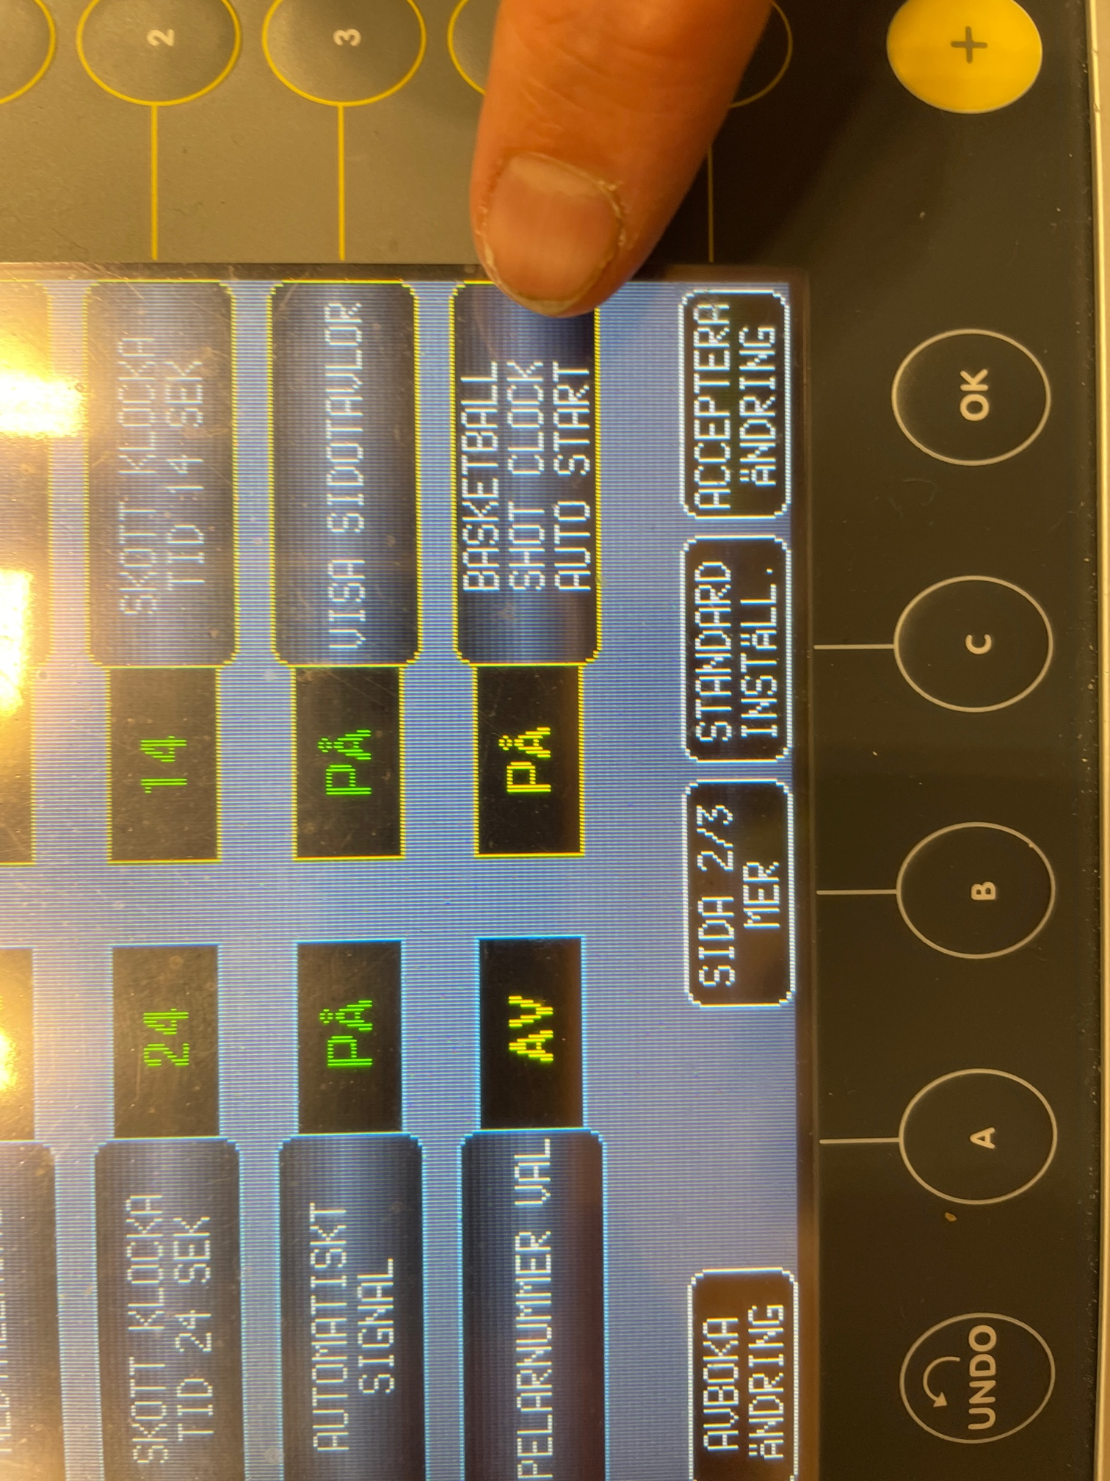
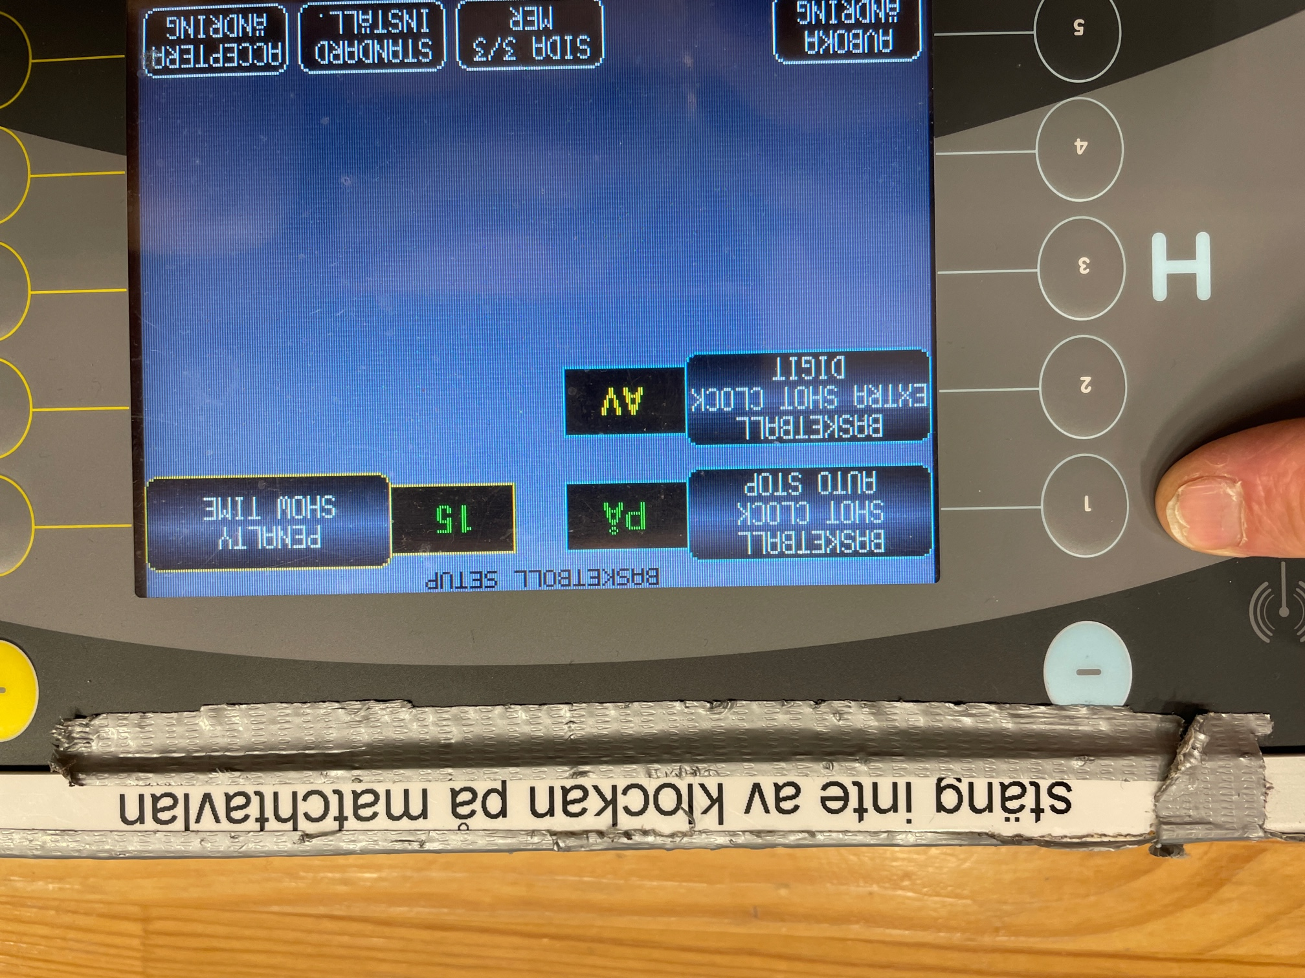
Here you set the game clock Starts AND Stops 24 seconds the clock automatically in Edsbergshallen.
TIPS! Tell the referee that you made this setup.
Then he understands how the 24-second clock behaves.

Slide 18
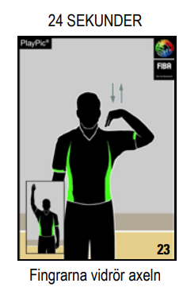
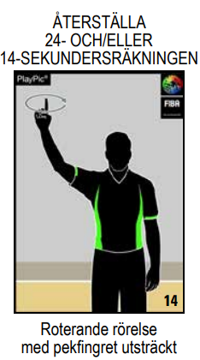
The referee decides! (the horn is only help)
The referee indicates that 24 seconds have passed.
The referee asks you to reset the clock - The referee decides!
The referee blows AND stops the match.
The other team gets the throw-in AND the game changes Direction
Tip!
Check which half the game is on..
Offense (14) or defence (24)!

Slide 19
Match AND Start new period
Yellow team half-court
Blue half-count – Where Yellow scores!
24
§ 29.1.1

Slide 20
”Uppkast” – Yellow team gets the ball by the arrow
Yellow team half-court
Blue half-count – Where Yellow scores!
24
14
Direction of play
Keep track of which half of the field the throw-in takes place from. It is the half of the field from which the throw-in takes place that controls 14 or 24 seconds.
§ 29.2.2

Slide 21
Yellow team shoot penalties
Tips
Yellow team half-court
Blue half-count – Where Yellow scores!
Penalties are always thrown in the offense half
14
ATTENTION! If the Other team takes the return - quickly change to 24 sec
§ 29.2.6

Slide 22
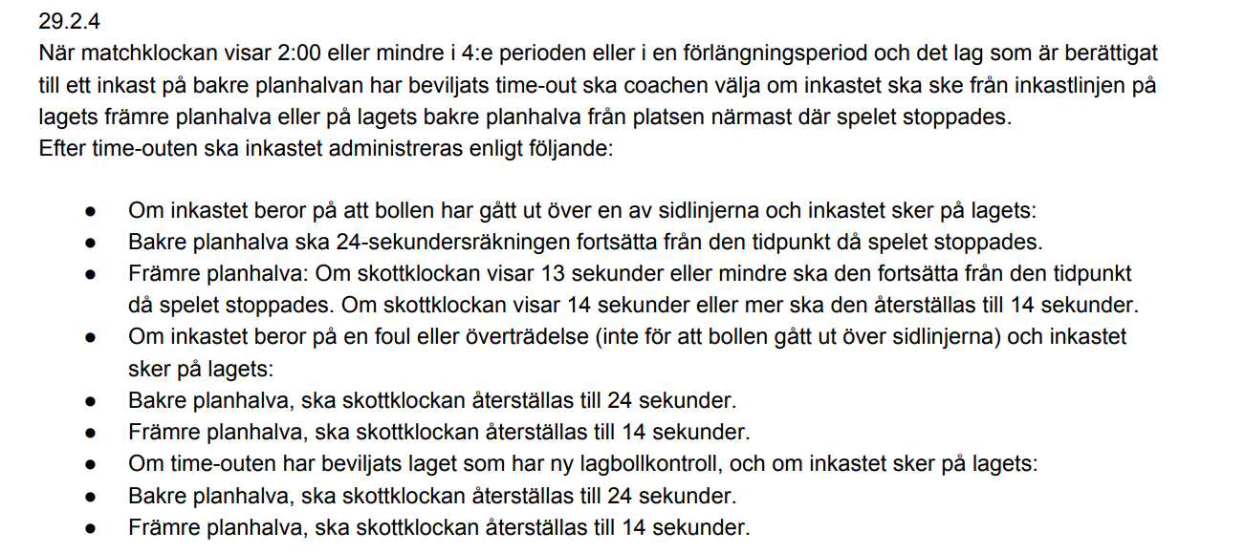
TIME OUT
Yellow team half-court
Blue half-count – Where Yellow scores!
Don't touch the clock! Generally, time continues where it was,
but here there are lots of rules…
Check with the referee!!
§ 29.2.4

Slide 23
Technical Foul (swearing, complaining about the referee, etc.)
Yellow team half-court
Blue half-count – Where Yellow scores!
Don’t touch the clock
§ 29.2.3

Slide 24
The End
At first 24 sec, because it is a throw-in after Score. The intercepted pass becomes a "Steal" when the opponents get hold of the ball = 24 sec again. Not 14…
Here are the official rules (in Swedish)
sbbf-officiella-spelregler-for-basketboll-2020.pdf
What if:
What should the Shot Clock be set to, when the team makes a throw-in after Score – AND the other team intercepts the pass and takes the ball

