Slide 1
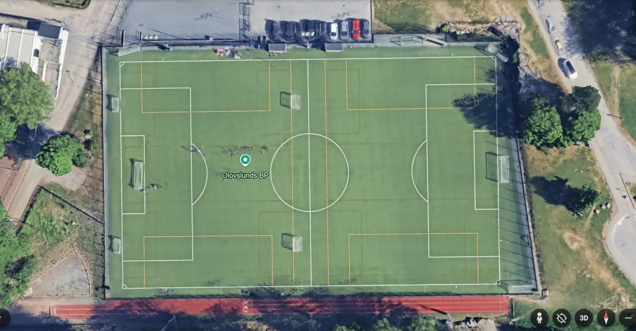
Olovslunds BP
Plan 115
Plan 125
Plan 116
Plan 126

Slide 2
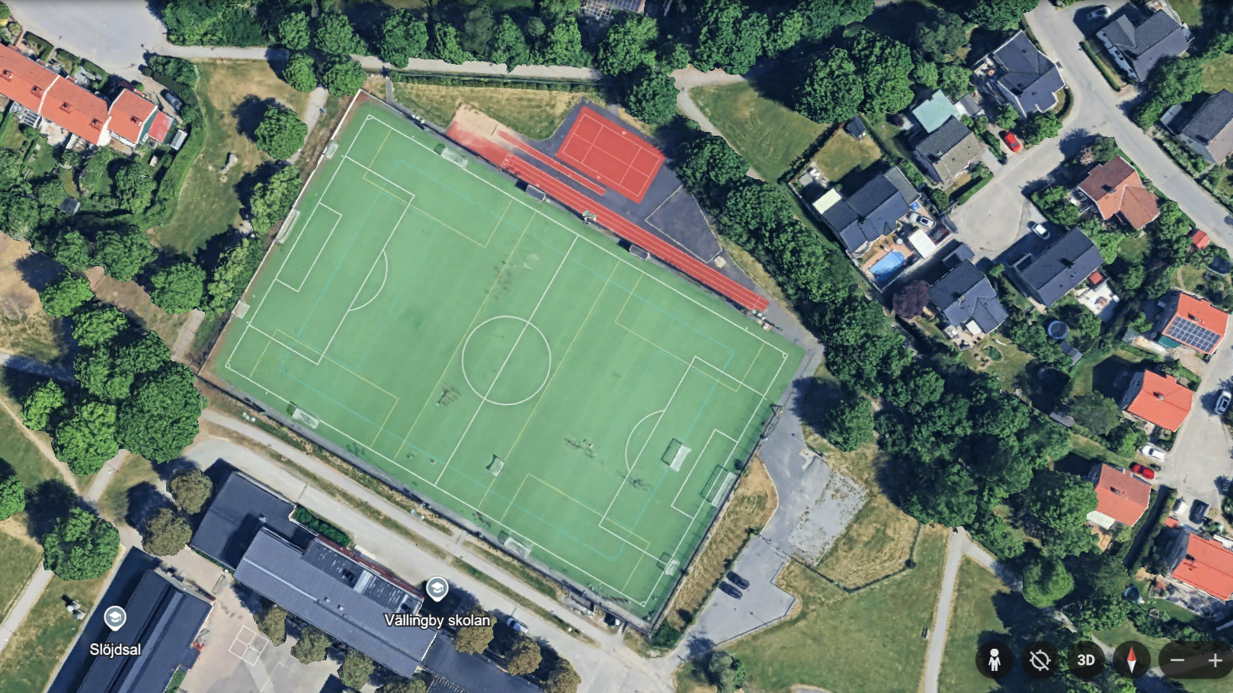
VÄLLINGBY
Plan 115
Plan 125
Plan 116
Plan 126

Slide 3
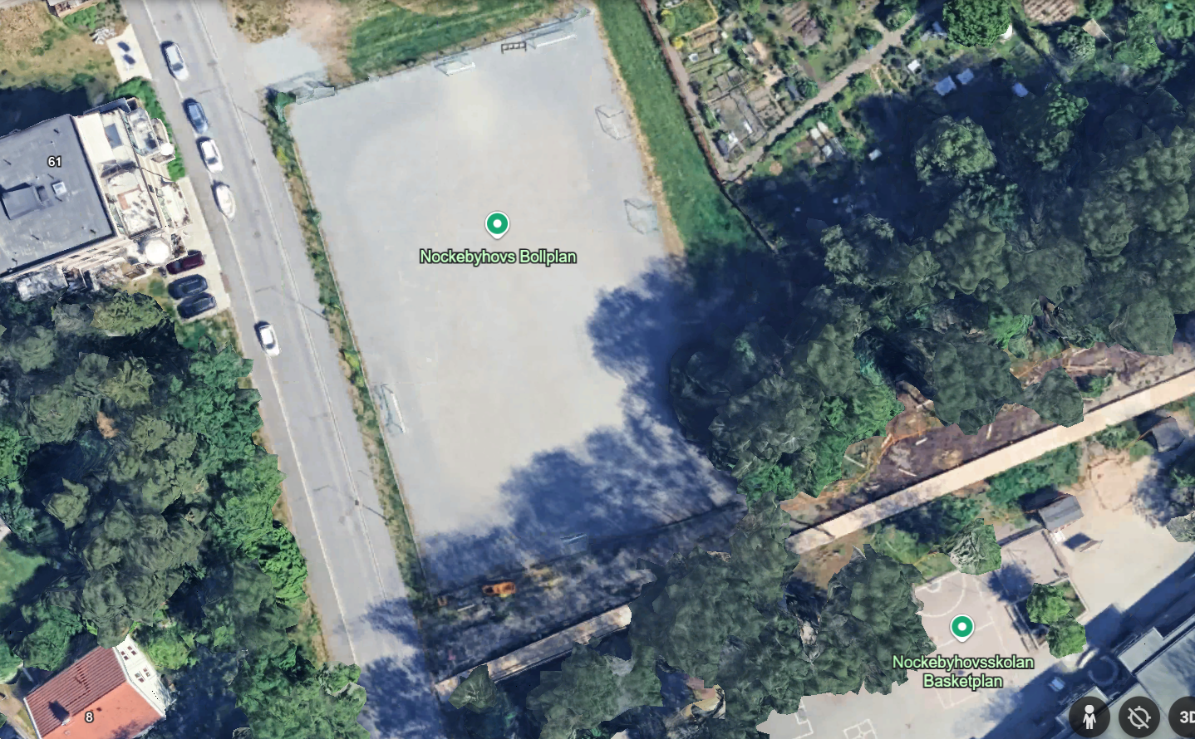
Plan 15
NOCKEBYHOV
Plan 16

