Slide 1
Verksamhetsplanen för 2026/2027
handlar framför allt om att fortsätta utveckla
Södertelge VBK som en bred, inkluderande och samtidigt sportsligt ambitiös förening.
Vi vill att det ska finnas en plats för alla
från Volleybompa och Ungdomsverksamhet till Motionsvolley, Beachvolley och Elitseriespel.
Kort sagt handlar verksamhetsplanen om bredd, utveckling, gemenskap och långsiktighet – samtidigt som vi fortsätter höja våra sportsliga ambitioner.

Slide 2

Notes:
[Sources]
Content based on the user-provided file "Bilaga 6. Verksamhetsplan 2026-2027.docx", primarily the section on overall objectives and inclusiveness. Visual background generated with OpenAI image generation for this presentation.

Slide 3
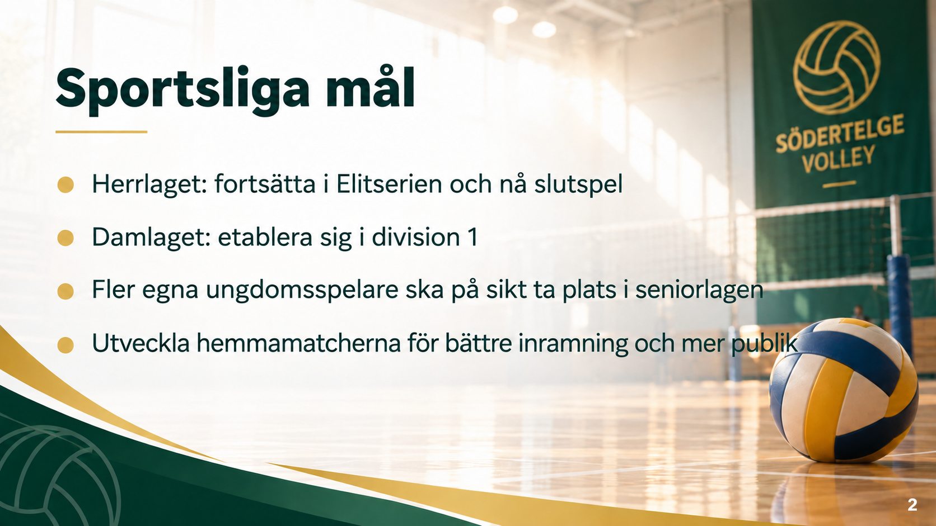
Notes:
[Sources]
Content based on the user-provided file "Bilaga 6. Verksamhetsplan 2026-2027.docx", primarily the sections on Herrar A and Damer A objectives. Visual background generated with OpenAI image generation for this presentation.

Slide 4

Notes:
[Sources]
Content based on the user-provided file "Bilaga 6. Verksamhetsplan 2026-2027.docx", primarily the sections on youth teams, leaders, training, and player development plans. Visual background generated with OpenAI image generation for this presentation.

Slide 5

Notes:
[Sources]
Content based on the user-provided file "Bilaga 6. Verksamhetsplan 2026-2027.docx", primarily the sections on senior broad activity, beach activity, Mälarbadet, LIU and school sport. Visual background generated with OpenAI image generation for this presentation.

Slide 6

Notes:
[Sources]
Content based on the user-provided file "Bilaga 6. Verksamhetsplan 2026-2027.docx", primarily the sections on sponsorship, member care, communication, organization and economy. Visual background generated with OpenAI image generation for this presentation.

